Slide 1

Heart Disease Prediction Using Hybrid Models MCR3
Progress Update

Slide 2
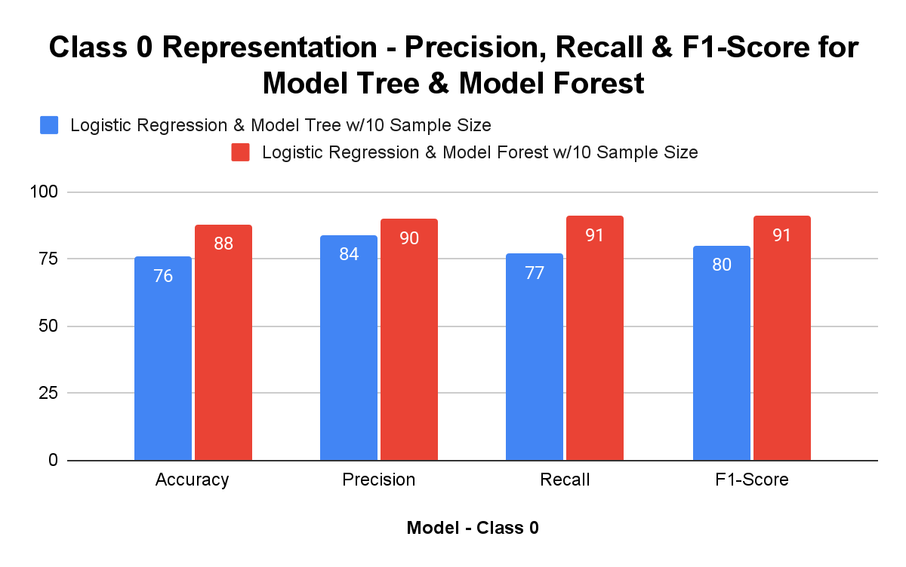
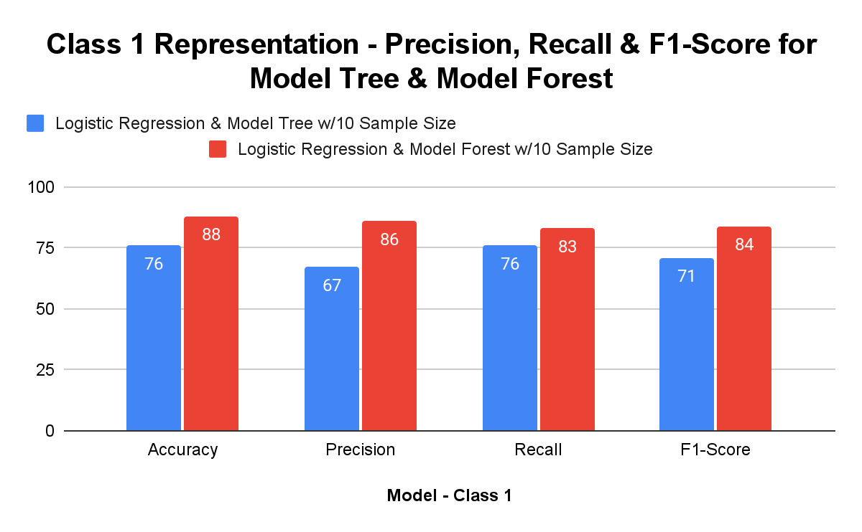
Model Switching and Results
ModelTree vs. ModelForest Implementation

Slide 3
Tabular Results
Model - Class 0 | Accuracy | Precision | Recall | F1-Score
Logistic Regression & Model Tree w/10 Sample Size | 76 | 84 | 77 | 80
Logistic Regression & Model Forest w/10 Sample Size | 88 | 90 | 91 | 91
Model - Class 1 | Accuracy | Precision | Recall | F1-Score
Logistic Regression & Model Tree w/10 Sample Size | 76 | 67 | 76 | 71
Logistic Regression & Model Forest w/10 Sample Size | 88 | 86 | 83 | 84

Slide 4
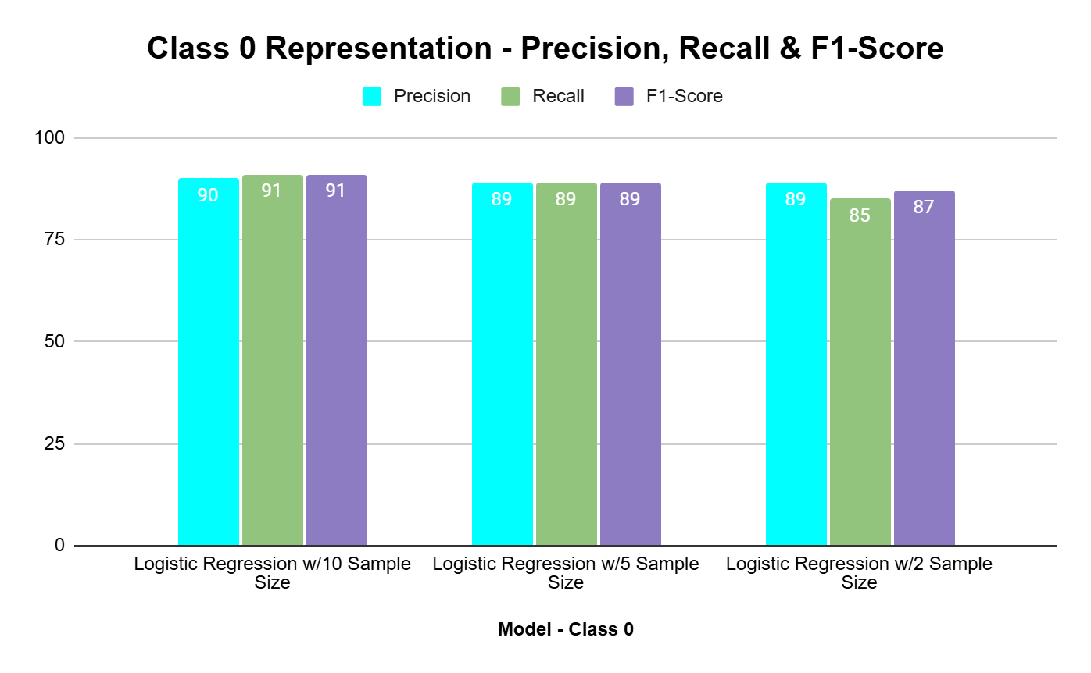
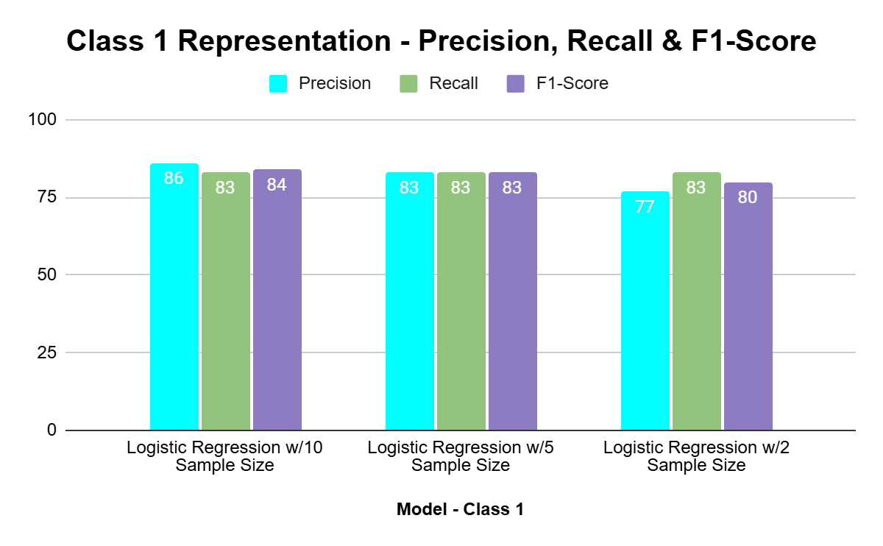
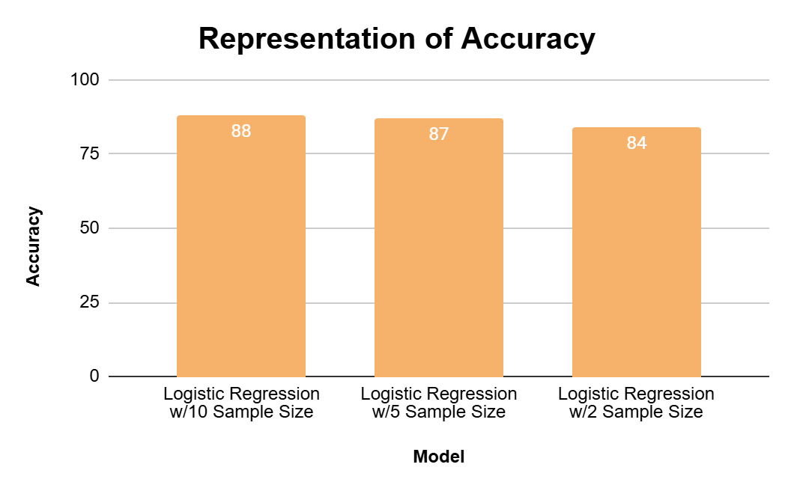
Model Switching and Results - Further Analysis of ModelForest Implementation

Slide 5
Tabular Results
Model - Class 0 | Precision | Recall | F1-Score
Logistic Regression w/10 Sample Size | 90 | 91 | 91
Logistic Regression w/5 Sample Size | 89 | 89 | 89
Logistic Regression w/2 Sample Size | 89 | 85 | 87
Model - Class 1 | Precision | Recall | F1-Score
Logistic Regression w/10 Sample Size | 86 | 83 | 84
Logistic Regression w/5 Sample Size | 83 | 83 | 83
Logistic Regression w/2 Sample Size | 77 | 83 | 80
Model | Accuracy
Logistic Regression w/10 Sample Size | 88
Logistic Regression w/5 Sample Size | 87
Logistic Regression w/2 Sample Size | 84

Slide 6


